Slide 1
Spokane math symposium: sustaining & re-framing our statewide work through the launch years initiative
November 12, 2019
Bill Moore
Director, K-12 Partnerships
State Board for Community and Technical Colleges

Slide 2
National HS math course-taking
Notes:
https://nces.ed.gov/fastfacts/display.asp?id=97

Slide 3
Table discussion
Why does the default high school math curriculum consist of Algebra 1 → Geometry → Algebra 2?
Why is “college readiness” (admissions, placement) defined by Algebra 2/Intermediate Algebra?

Slide 4
Math usage of “freakonomics” podcast listeners
Notes:
Youcubed.org

Slide 5
Persistent equity gaps
CTC completion of college-level math

Slide 6
LAUNCH YEARS INITIATIVE
Notes:
Streamlining the transition for students from high school to college math
“From college-ready students to student-ready colleges”

Slide 7
LAUNCH YEARs: Key RECOMMENDATION
Offer multiple effective, aligned pathways at secondary and post-secondary institutions with state policies supporting student transitions, including:
Coherent, consistent system for students to demonstrate college readiness (placement)
Baccalaureate admissions policies that support aligned math pathways
Robust support systems to help students navigate pathways
Notes:
Draft work from national consensus panel

Slide 8
current Washington work supporting students in the transition from high school to college math
Placement agreement
Bridge to College

Slide 9
Math placement
Math& 107 (Math in Society), Math& 146 (Statistics), or their equivalents
Other entry-level math courses (including pre-calculus)
1) Level 3 or 4 score on high school Smarter Balanced assessment plus
a) B or better in Algebra 2, and
b) successful completion (passing grade) of one math course in the junior or senior year OR
Smarter Balanced Level 3 or 4 plus
AND
2) B or better in a high school pre-calculus or higher course
2) B or better grade in designated Bridge to College Math class as a senior
Notes:
Eliminated requirement of specific Smarter Balanced score for placement with Bridge to College
Added course success requirements for math in addition to Smarter Balanced score
Still applies for graduating seniors and dual-credit students
Extended through Class of 2022
Colleges continue to be able to adjust agreement terms to be more favorable for students

Slide 10
Ongoing challenges
Burden on students to provide scores
Communication issues with high school and college staff
Variations in use of high school transcripts, local score reporting formats, processes

Slide 11
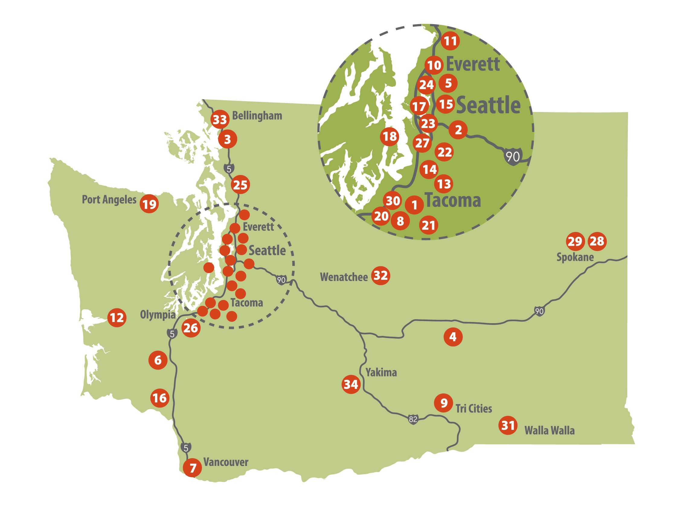
Bridge to College Participation
2018-19
137 districts
225 high schools
490 teachers
(265 math, 225 ELA) (181 new)
26
19
64
14
36
13
12
21
17
# of Bridge to College high schools by ESD
Notes:
Pathway for students scoring below “college-ready” on the high school assessment
Jointly developed and coordinated by college faculty and high school teachers
Ongoing professional learning support for teachers
Slightly up overall from 2018-19

Slide 12
Multiple measures options
MEASURES | APPROACHES | PLACEMENTS
Administered by college (tests, computer assessments, writing samples, …) Obtained from elsewhere (HS assessments, transcripts, GPA) | Waiver Decision rules Decision bands Formula (algorithm) Directed self-placement | Traditional courses Alternative coursework Support services
Toward Better College Course Placement
Cullinan et al, July 2018
Cullinan & Yang
SHEEO, August 2017
Notes:
UC admissions uses self-report but
verifies after admission. In 2008, at 9
campuses, 60,000 students. No
campus had >5 discrepancies b/w
reported grades and student
transcripts (HeNs, 2016)
• College Board: Shawn & MaNen,
2009: “Students are quite accurate in
reporHng their HSGPA”, r = .73.
• ACT research oden uses self-reported
GPA and generally find it to highly
correlated with students actual GPA:
ACT, 2013: r = .84.

Slide 13
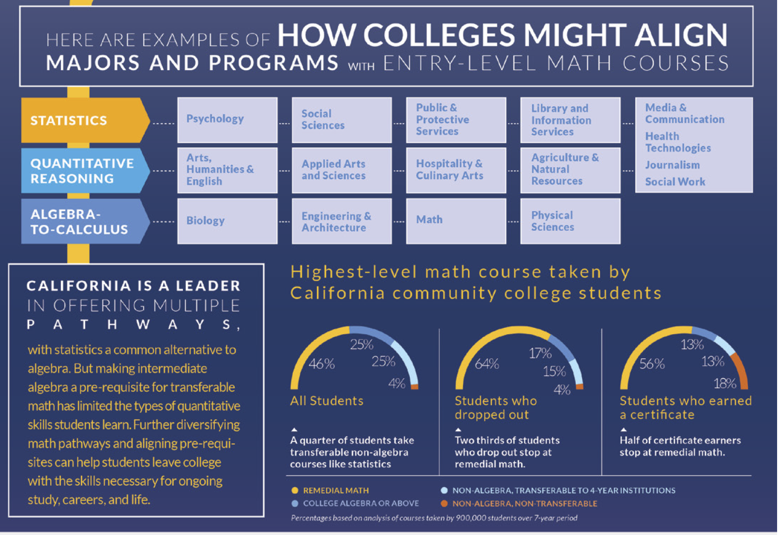
MATH AND GUIDED PATHWAYS

Slide 14
Rethinking the role of math in educational equity
Pam Burdman, Just//Equations
Notes:
Math policies have the potential to support equity when:
all math pathways are rigorous, rich, and relevant to college and/or career success;
students’ pathways are based on their goals and aspirations, rather than on perceived skill or outmoded placement practices;
prerequisites are not arbitrary gatekeepers; and
students receive the instruction and other support they need to be successful in their chosen pathway (including bridges between pathways for students whose goals change)

Slide 15
Questions?
Contact: Bill Moore
bmoore@sbctc.edu
(O) 360.704.4346
(C) 360.528.1809

